Slide 1
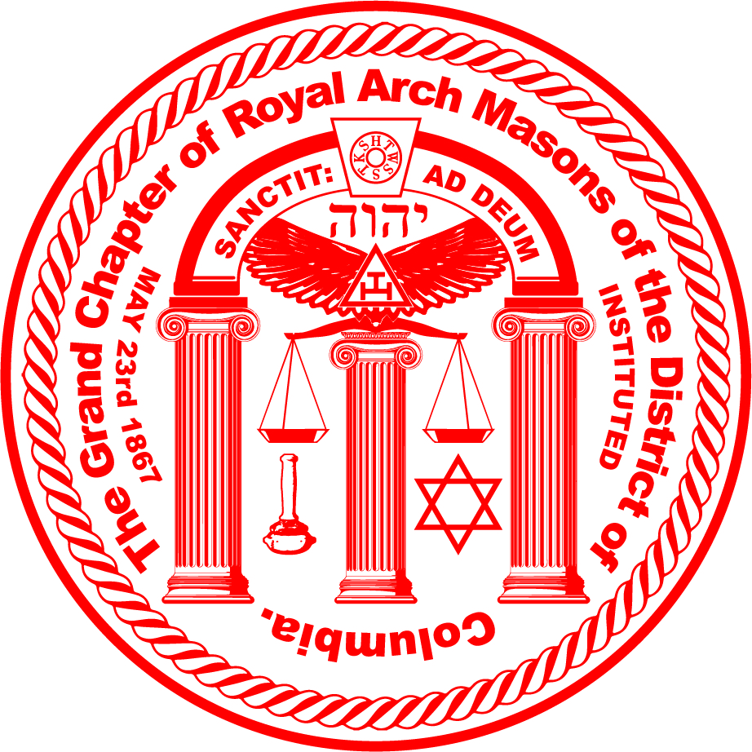
Principals and Pillars The Characters in Craft and Capitular Masonry
Nicholas J. Sampogna Grand High Priest Grand Chapter of Royal Arch Masons of the District of Columbia

Slide 2
Characters in Ritual, Character in Lodge.
Who are they?
In our degrees and in our history.
Who/what do these characters represent?
How do they help tell our story?
What lessons can we learn from them?

Slide 3
How were they introduced?
Many important characters were not introduced through ritual ceremony, but educational catechisms
These were meant to teach, much like in churches, man’s relationship to God.
Highlighted the important figures and tenants to teach membership.
When we understand the Masonic tradition laid out in this way, we begin to appreciate why it is that Dr. Anderson, as the compiler of the first Premier Grand Lodge Constitutions, could claim even Adam as a Mason, describe the early Accepted Masons as Noachidae or sons of Noah, and Shem, and Japheth as ’Masons True.”
- Rev. Neville Barker Cryer The Royal Arch Journey
Notes:
It’s important to remember that with the practice of catechisms, there were no degree ceremonies as we know today. The “catechism” or back and forth call and response was a way to not only share information in an engaging way, it allowed the participant to be tested as he was undergoing the knowledge transfer. Finally, and most importantly for our reasons, it allowed the original “characters” of the degrees to be interchangeable, thereby allowing the candidate to take away a myriad of lessons from the Bible.

Slide 4
How were they introduced?
Many important characters were not introduced through ritual ceremony, but educational catechisms
These were meant to teach, much like in churches, man’s relationship to God.
Highlighted the important figures and tenants to teach membership.
Notes:
This again is important to note – it showcases that this technique was adopted from protestant leaders and gave the would-be initiators the ability to teach different lessons based on the catechism. In this case, Hiram Abiff could be a number of different biblical figures – and is most likely the reason why modern ritual has developed with so many variations on who the candidate actually represents.

Slide 5
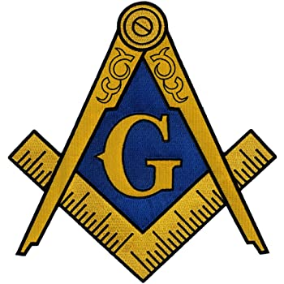
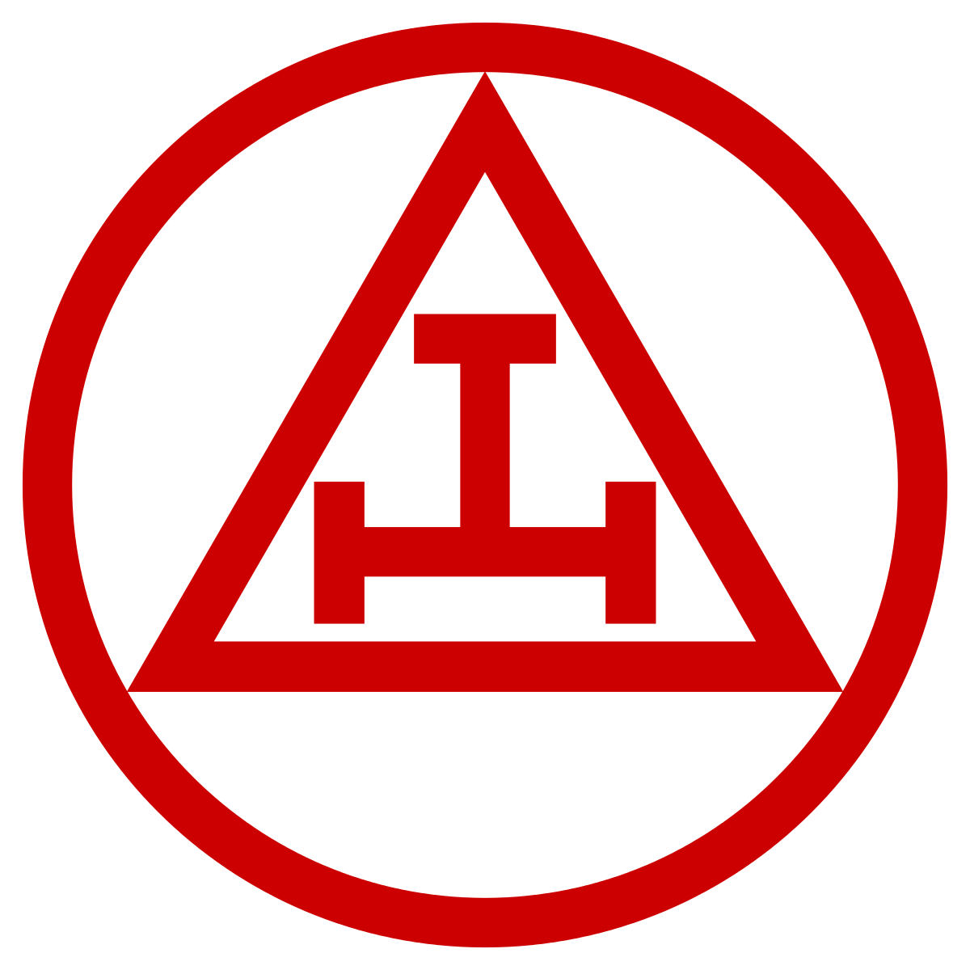
The Characters
Solomon, King of Israel
Hiram, King of Tyre
Hiram Abiff
Zerubbabel
Joshua
Haggai

Slide 6
The Characters
Craft Masonry
Solomon, King of Israel
Solomon gave orders to build a temple for the Name of the Lord and a royal palace for himself. He conscripted 70,000 men as carriers and 80,000 as stonecutters in the hills and 3,600 as foremen over them. 2 Chronicles 1
Hiram, King of Tyre
And the LORD gave Solomon wisdom, as he promised him: and there was peace between Hiram and Solomon; and they two made a league together. Kings-1 5:12 Hiram Abiff
And king Solomon sent and fetched Hiram out of Tyre. He was a widow's son of the tribe of Naphtali, and his father was a man of Tyre, a worker in brass: and he was filled with wisdom, and understanding, and cunning to work all works in brass. And he came to king Solomon, and wrought all his work. 1 Kings 7:13-14
Capitular Masonry
JOSHUA Take the silver and gold and make a crown, and set it on the head of the high priest, Joshua son of Jozadak. Tell him this is what the Lord Almighty says: ‘Here is the man whose name is the Branch, and he will branch out from his place and build the temple of the Lord. It is he who will build the temple of the Lord, and he will be clothed with majesty and will sit and rule on his throne. And he will be a priest on his throne. And there will be harmony between the two. Zechariah 6:11-13 ZERUBBABEL
Then the word of the Lord came to me: “The hands of Zerubbabel have laid the foundation of this temple; his hands will also complete it. Then you will know that the Lord Almighty has sent me to you. Zechariah 4:8-9
HAGGAI Then Haggai, the Lord’s messenger, gave this message of the Lord to the people: “I am with you,” declares the Lord. So the Lord stirred up the spirit of Zerubbabel son of Shealtiel, governor of Judah, and the spirit of Joshua son of Jozadak, the high priest, and the spirit of the whole remnant of the people. They came and began to work on the house of the Lord Almighty, their God, on the twenty-fourth day of the sixth month. Haggai 1:13-15

Slide 7
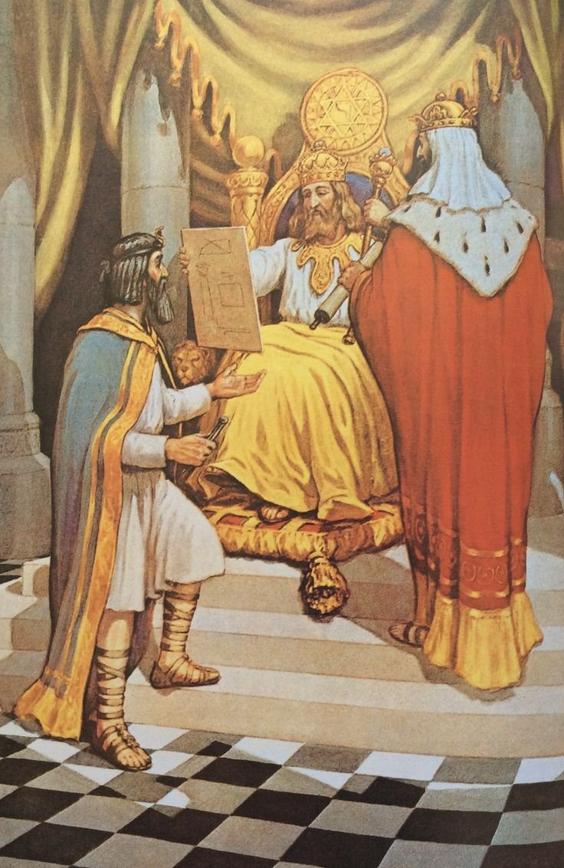
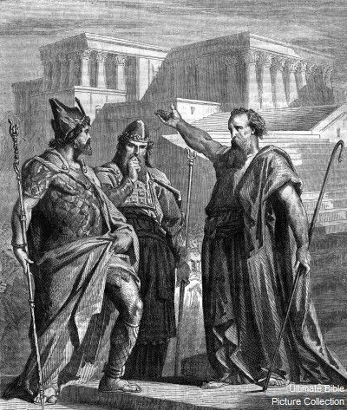
Who Are They?
Solomon, King of Israel
Hiram, King of Tyre
Hiram Abiff
Zerubbabel
Haggai Joshua

Slide 8
To a Modern Master Mason…
Solomon, King of Israel Wisdom
Hiram, King of Tyre
Strength Hiram Abiff
Beauty
Joshua
Faith
Haggai
Hope Zerubbabel
Charity
Notes:
This slide should speak to the relationship each member should learn from the interpersonal connection that exists between each character in the ritual and how it should affect our portrayal in the Lodge. It’s most likely helpful to re-read the passage from the Master Mason lecture on Wisdom, Strength, and Beauty here. We often speak about the candidate’s relationship to Hiram Abiff, but what is the relationship between Solomon and Hiram, King of Tyre? How do we extrapolate that to our modern meetings – what should our Senior Warden do for our Worshipful Masters? If presenting to non-RAM members, explaining who Joshua, Haggai, and Zerubbabel are in the context of Faith, Hope, and Charity may be useful. As each of their characters have their own personal Biblical descriptions and functions– it is easy to correlate them with Faith, Hope and Charity.

Slide 9
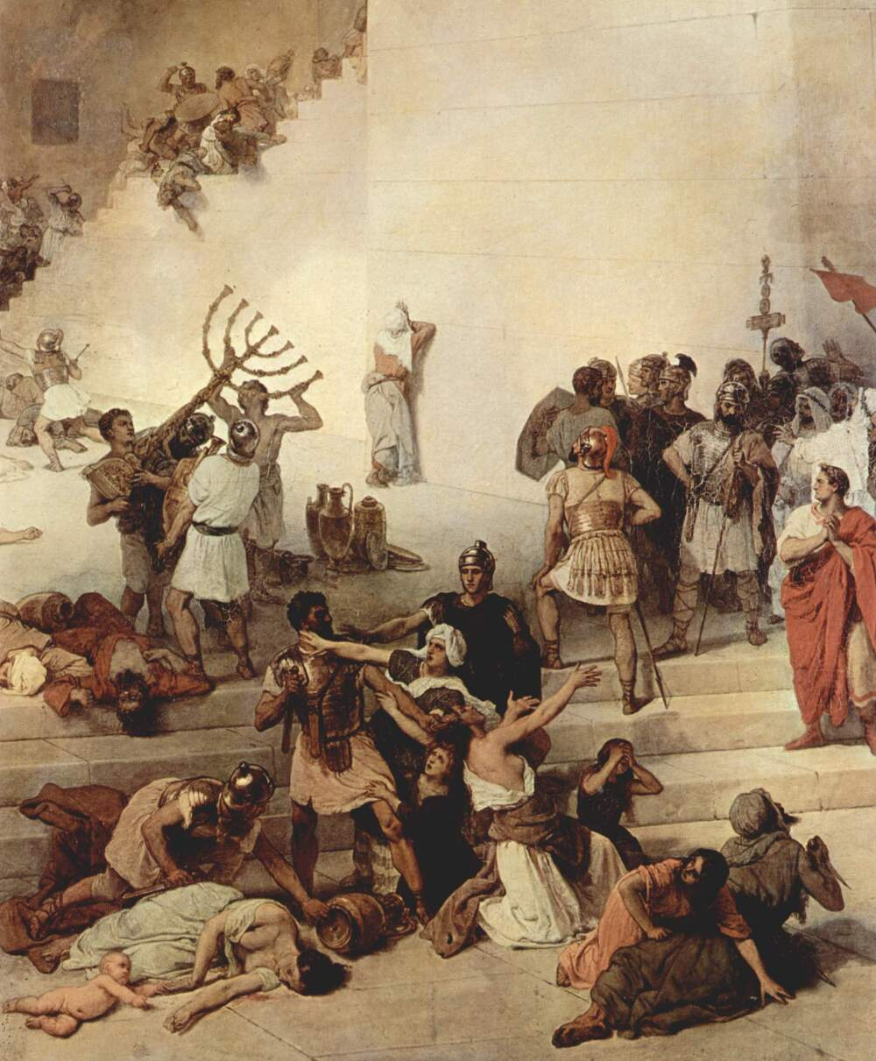
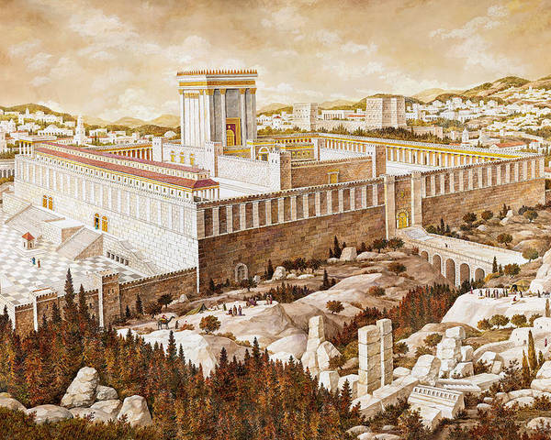
What Role Do They Play in our Lives?
The Master Mason Degree as the first haute-grade
“The most expert of the Fellow-Craftsmen shall be chosen or appointed the Master, or Overseer of the Lord’s work.”
Anderson’s Constitutions
The notion of the ”completion” of the Master Mason Degree.
The Concept of “Rededication.”
Notes:
It is important to remind members that the Master Mason degree was truly a “chair” degree at first. None of the theatrics, none of the symbology, just a true “passing” for those who had been elected from the workmen. We should then not look at the Royal Arch degree as the completion of the MM degree (although it’s easy to understand why we do), but more of a rededication to the principles of our Craft Lodges. Zerubbabel’s task was to rebuild the Temple to God, not imitate and make better than King Solomon, so in that sense it’s less about “completing the work” but providing a place for a new nation of Jews to worship. This can be cited in the Ahiman Rezon.

Slide 10
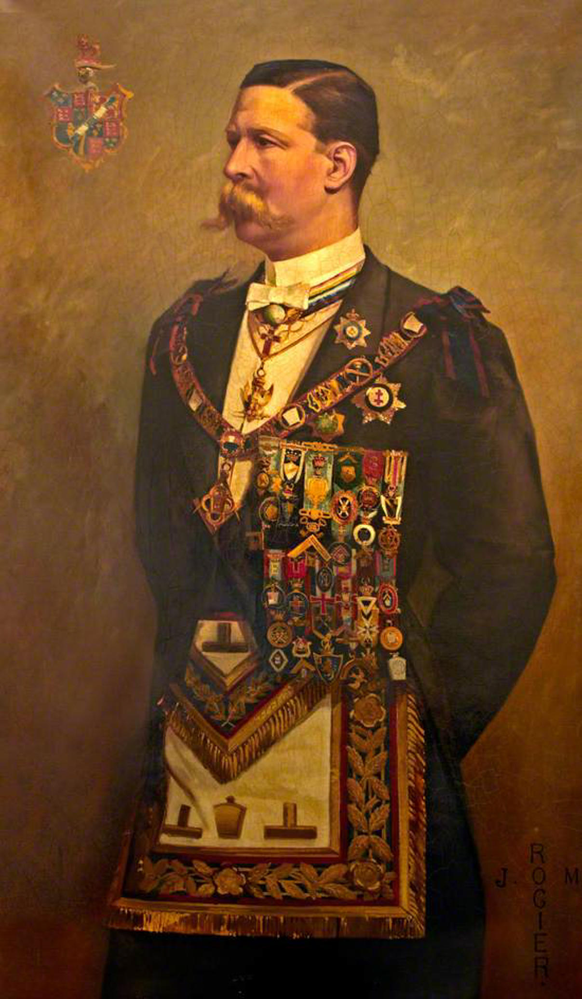
Lodges to God, Chapters to Zerubbabel
What value and virtues are we practicing?
Do we make earthly and fraternal change?
The Temple within us…
Just one of my favorite Masonic photos. Henry James FitzRoy, Earl of Euston in his Provincial Grand Mark Master regalia.

Slide 11
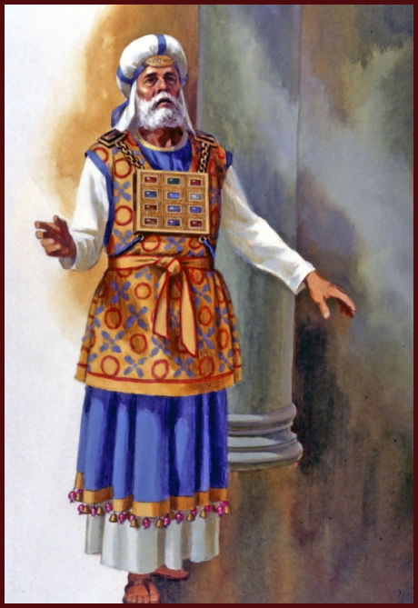
Cited Texts & Suggestions
The Royal Arch Journey, Rev. Neville Barker Cyrus
What do you know about the Royal Arch, Rev. Neville Barker Cyrus
Coil’s Masonic Encyclopedia, Henry Wilson Coil
The Constitutions of Free-Masons, James Anderson
The Ahiman Rezon, Laurence Dermott, Constitution for the Antients Grand Lodge

Slide 12
Principals and Pillars The Characters in Craft and Capitular Masonry
THANK YOU!

